Slide 1
Objective 3.3
Compare
the House of Representatives
and
the Senate

Slide 3
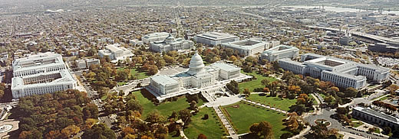
U.S. Capitol
Washington, D.C.

Slide 4
the west side of the Capitol

Slide 5
the west side of the Capitol

Slide 6
the east side of the Capitol

Slide 7
Capitol

Slide 9
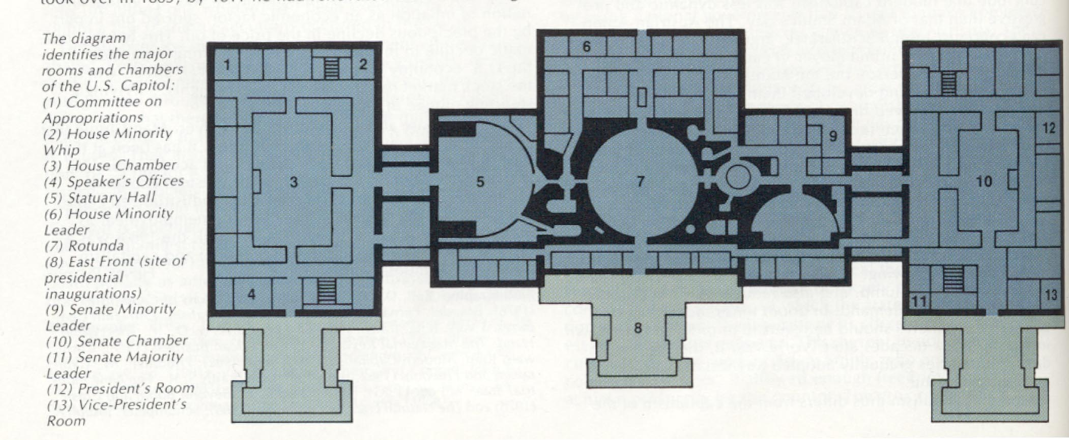
House
Senate

Slide 10
the
House
stuff

Slide 12
House of Representatives number of members
435

Slide 13
House of Representatives number of members
Each state is given representation based on its population and has at least one

Slide 14
House of Representatives qualification for membership
Be at least 25 years old

Slide 15
House of Representatives qualification for membership
Have been a U.S. citizen for at least 7 years

Slide 16
House of Representatives qualification for membership
Live in the state where you are elected (and district)

Slide 17
House of Representatives terms of office
Elected for a 2-year term

Slide 18
House of Representatives terms of office
At the end of each set of two years, the entire House is up for election again

Slide 19
House of Representatives terms of office
May be re-elected as many times the voters of your district want to elect you

Slide 20
House of Representatives responsibilities
(things that the House can do but the Senate can’t)

Slide 21
House of Representatives responsibilities
Start tax bills
(appropriations)
(then go to the Senate)

Slide 22
House of Representatives responsibilities
Bring charges of impeachment against government officials
(impeach is only accusing)

Slide 23
House of Representatives responsibilities
Elect U.S. President if electoral college doesn’t give any candidate a majority vote

Slide 24
House of Representatives rules for debate
“Rules Committee” decides when and for how long a bill will be debated

Slide 25
House of Representatives presiding officers
Speaker of the House

Slide 26
House of Representatives presiding officers
Majority Leader
Majority Whip
Minority Leader
Minority Whip
Republicans
Democrats

Slide 27
the
Senate
stuff

Slide 28
Senate

Slide 29
Senate number of members
100

Slide 30
Senate number of members
Each state has two Senators.

Slide 31
Senate number of members
Because there are only two from each state they think they are special and “upper”.

Slide 32
Senate qualification for membership
30 years old

Slide 33
Senate qualification for membership
Have been a U.S. citizen for at least 9 years

Slide 34
Senate qualification for membership
Live in the state where you are elected
(whole state votes)

Slide 35
Senate terms of office
Elected for a term of
6 years

Slide 36
Senate terms of office
Senators’ terms over-lap

Slide 37
Senate terms of office
Senator “A” takes office in 2009 (for 6 years)
Senator “B” takes office in 2011 (for 6 years)

Slide 38
Senate terms of office
Every two years 1/3 of the Senators are up for re-election

Slide 39
Senate terms of office
May be re-elected as many times as the voters want

Slide 40
Senate responsibilities
Approve (or not) appointments which the President makes
(this is called “approving”)

Slide 41
Senate responsibilities
Approve (or not) treaties which the President signs
(this is called “ratifying”)

Slide 42
Senate responsibilities
Hold trial for government officials who are impeached by the House

Slide 43
Senate responsibilities
Elect Vice President of the U.S. if the electoral college doesn’t give any candidate a majority vote

Slide 44
Senate rules for debate
“filibuster” is allowed
(unlimited time on talking)

Slide 45
Senate rules for debate
“cloture” can stop filibuster (vote takes 60 Senators)

Slide 46
Senate presiding officers
U.S. Vice President

Slide 47
Senate presiding officers
President Pro Tem

Slide 48
Senate presiding officers
Majority Leader
Majority Whip
Minority Leader
Minority Whip

Slide 49
the
House
side
the
Senate
side

Slide 51
All 535 members of Congress are called “Congressmen”

Slide 52
Additional information

Slide 53
Each “Congress” is given a number.

Slide 54
How long does a “Congress” last?

Slide 55
Two years. This is called a “term”

Slide 56
The two year term (or Congress) is divided into two parts called sessions

Slide 57
Each session lasts one year.

Slide 58
Congressmen have some special benefits:

Slide 59
free office space, free staff, free trips to and from Washington

Slide 60
do not pay postage; this is called franking privilege

Slide 61
immunity; therefore cannot be sued for what they say in debate

Slide 62
Congressmen are paid $174,000 per year

