Slide 1
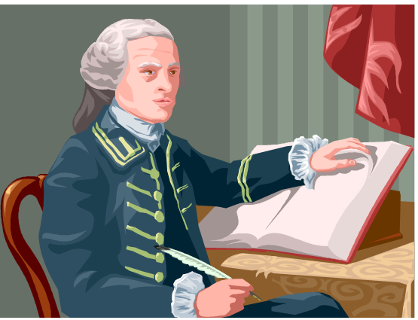
WEAKNESSES AND RESULTS OF THE ARTICLES OF CONFEDERATION

Slide 2
NO POWER TO TAX!!
Weakness:
Congress had no power to lay or collect taxes.
Result:
The government was short of money, could not provide services, raise an army, or pay debts.

Slide 3
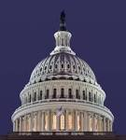
WEAK CENTRAL GOVERNMENT
Weakness:
Central government was weak, Power resided with the states
Result:
Economic quarrels among the states broke out. There was difficulty in arranging for trade with other states. States did not enforce federal laws

Slide 4
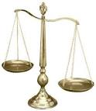
NO POWER TO ENFORCE LAWS
Weakness:
Congress had no power to enforce federal laws.
Result:
The government depended on the states to enforce the laws, which they did not always do.

Slide 5
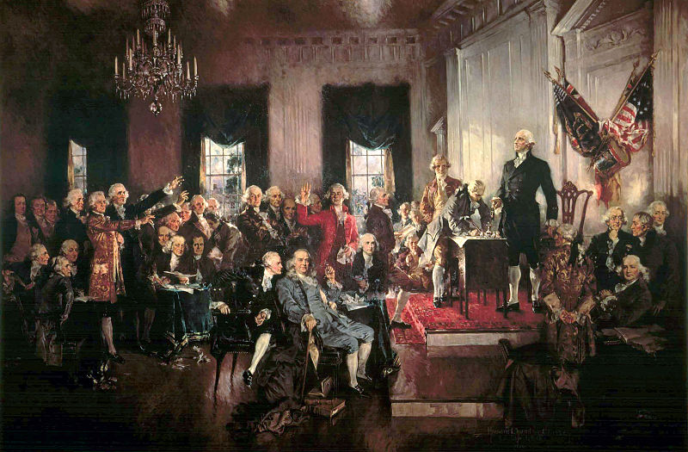
ONLY ONE BRANCH OF GOVERNMENT!!
Weakness:
Approval of 9 states was needed to enact laws. (69% of states is NOT a simple majority!)
Result:
It was difficult to enact laws in a timely manner.

Slide 6
NO WAY TO CHANGE THE ARTICLES
Weakness:
Amendments to the Articles required the consent of all 13 states.
Result:
It was almost impossible to change the powers of government.

Slide 7
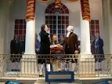
NO EXECUTIVE BRANCH
Weakness:
The government had no executive branch to enforce federal laws.
Result:
There was no effective way to coordinate the work of the government. No president or official leader

Slide 8
NO NATIONAL COURT SYSTEM
Weakness:
There was no national court system
Result:
The central government had no way of settling disputes among the states.

